Slide 1
Deep Behavioral Biometrics
Advisor: Dr. Jonathan Voris
Students: Josiah-David Sykes, Randy St. Fleur

Slide 2
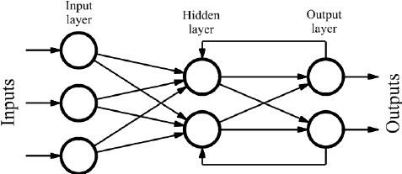
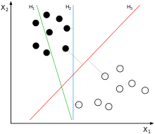
Question?
Can we use neural networks to increase the accuracy of behavioral biometric authentication on a mobile device in relation to a support vector machine(SVM)?
VS
Graphical Representation of a SVM[1]
Graphical Representation of a Recurrent Neural Network[7]

Slide 3
Why?
Cost - It would be cheaper than using fingerprint scanner or iris scanner.
The FaceID system in the popular Iphone X cost $16.70[5]
Security - Not susceptible to observational attacks unlike graphical authentication schemes as it relies on purely implicit user behavior that is unique to an individual [4]
Chances of spoofing are diminished due to a large amount of “features” that make up a user's general interaction with a device [4]

Slide 4
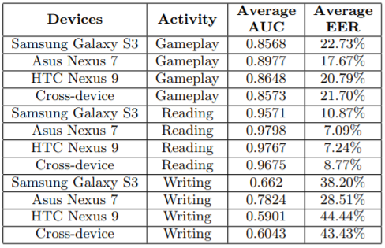
Previous Research/Work
Touch Screen Biometrics Across multiple devices[4]
User were given multiple task across different applications and their usage data was recorded
A SVM was used to classify their data and it was found that reading provided the best result

Slide 5
Resources
Python:
Ease of use, many frameworks for data analysis (e.g: pandas, numpy)
Numpy: Support for large multi-dimensional arrays and matrices and high level functions to operate on these arrays.
Pandas: Offers data structures and operations for manipulating numerical tables and time series.
Tensorflow:
Quick prototyping, open source
Can be used with any device that has a browser. (tf.js)
New features constantly emerging (tf.lite) Introducing Android NN Api
Automatically updates certain variables in background Tensorflow “Computation Graph” where all computations are run in a session outside of Python in C++. e.g: x = tf.placeholder(*datatype*, *shape*)
Multiple types of Neural Networks

Slide 6
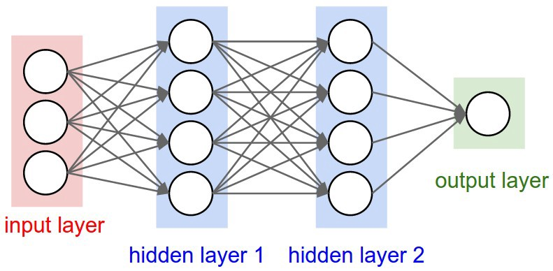
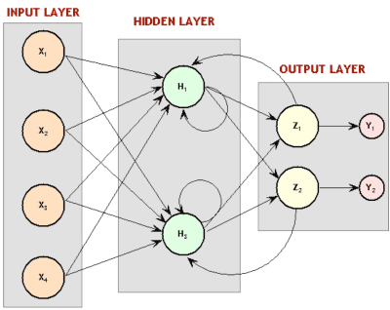
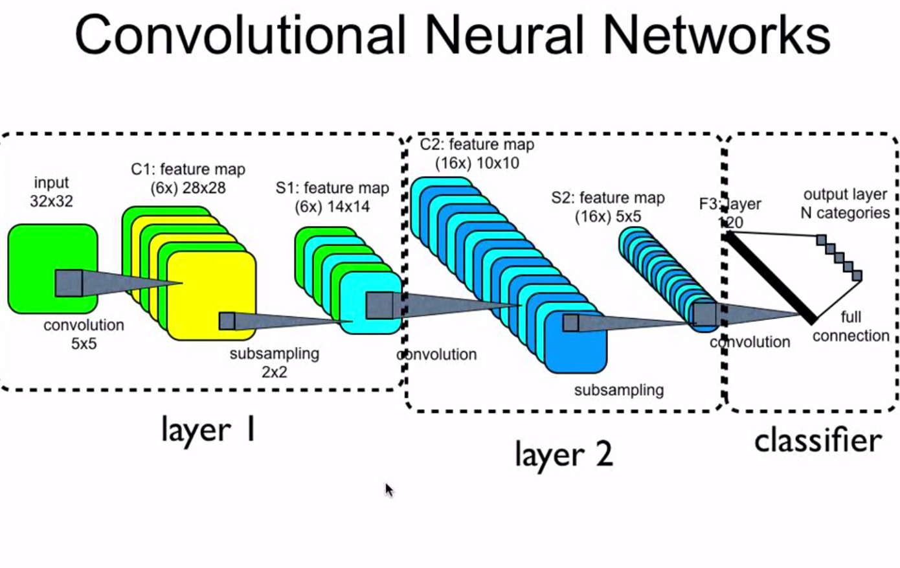
What is the right model for our user data?
Feed Forward [6]
Recurrent [6]
Multilayer Convolutional [6]
Good for Patternization:
“Great at finding patterns and using them to classify images” Compares individual “parts” of dataset against the entirety of that dataset. [2]
Good for Classification:
Straightforward and associates input with output. Will learn users habits as device is used and later be able to differentiate between user habits.
Good for Temporal Data:
Contains cycles within structure that can allow “memory” of previous output for reuse. Works well with data that segments information into “time slices” [3]

Slide 7
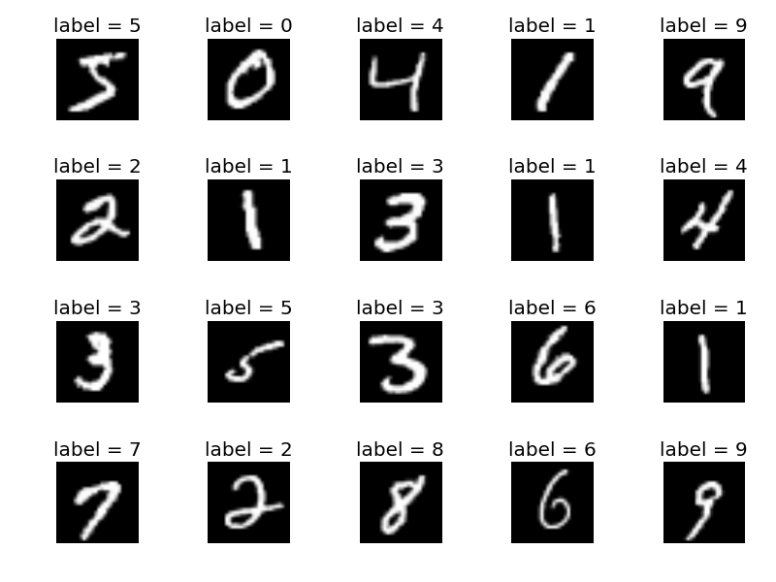
Accuracy Results on MNIST Image Dataset
Mnist is an image dataset of images represented by bright or dim pixels (1 or 0).
Feed Forward: 95% Accuracy (Runtime: approx. 2 mins)
500 Nodes per layer; 5 Layers: 1 Input, 3 Hidden, 1 output layer with 10 classes
10 Epochs
Convolutional: 99.2% Accuracy (Runtime approx. 27 mins)
5 Layers: 1 Input, 2 Convolutional, 1 Densely Connected, 1 Readout (with prior dropout for reduction of overfit)
20,000 Epochs

Slide 8
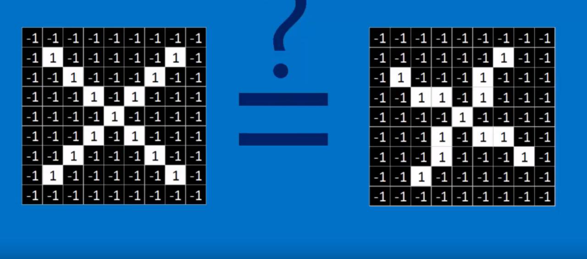
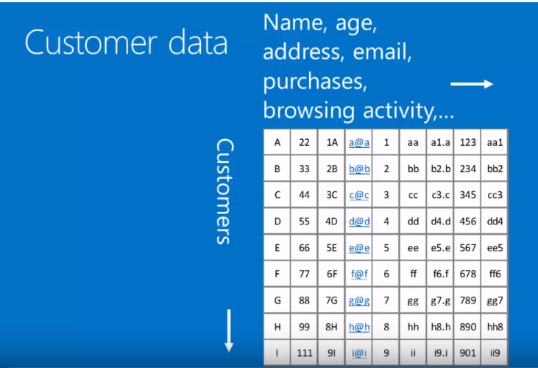
Limitations: Multilayer Convolutional
“Only captures spatial [next to] patterns in data. If the data cannot be manipulated to look like an image, convolutional networks are less useful” [2]
Condition: “Things closer together, are more closely related than things farther away” [2]

Slide 9
Goals
Decide on the Structures of each neural network
Classify each user
First with two users then four and eventually all 31 users
See if the accuracy results from the svm and the application used remains the same with the different neural networks

Slide 10
Future Work
Test to see if the data received correlates among different devices. I.e a user biometric signature is the same across different mobile devices
(Tensor Lite) ----Bringing offline model to mobile device

Slide 11
Citations
“Support Vector Machine.” Wikipedia, Wikimedia Foundation, 30 Apr. 2018, https://en.wikipedia.org/wiki/Support_vector_machine
Rohrer, Brandon. “How Convolutional Neural Networks Work.” YouTube, YouTube, 18 Aug. 2016, www.youtube.com/watch?v=FmpDIaiMIeA.
Lavenko, Victor. “Neural Networks 5: Feedforward, Recurrent and RBM.” YouTube, YouTube, 31 Aug. 2015, www.youtube.com/watch?v=epS9UVRuoOE&t=19s.
Voris, Jonathan, and Tuan Nguyen. “Touchscreen Biometrics Across Multiple Devices”. NYIT, New York Institute of Technology, 2017,d4fef2f3-a-13130ea6-s-sites.googlegroups.com/a/nyit.edu/jvoris/way_17.pdf?attachauth=ANoY7cosW_ilUTszmsB-Y1VaNrBLArE7vbHQCKy8WOifOgmLxTJrXnT1veKvSjXd124bb6TWPE7zzQ4TbzN1S1cwaia8ulawMT-FGD-mj4jyB62i3t_rxfFDVzF4HNl6av_yh4M683yrEZJYo-HZC8wGMybuY604TfII5mP1TuZ6a8HHwW-LU6I7f7lMi2Ek6HdkLQSM4SEx&attredirects=0.
Shaw, Lucas, et al. “Apple Plans to Sell Video Subscriptions Through TV App.” Bloomberg.com, Bloomberg, 9 May 2018, www.bloomberg.com/news/articles/2018-05-09/apple-is-said-to-plan-selling-video-subscriptions-through-tv-app.
Google, Google, images.google.com/.
Quiza, Ramon and Davim, J. “Computational modeling of machining systems.” Researchgate, Researchgate, 2009, https://www.researchgate.net/figure/Graph-of-a-recurrent-neural-network_fig3_234055140.

